Slide 1
Bayesian Inference
Dr. Uzair Ahmad

Slide 2
Contingency Tables
Join, Conditional, Marginal Probability
Bayes’ Formula
Check for Independence

Slide 3
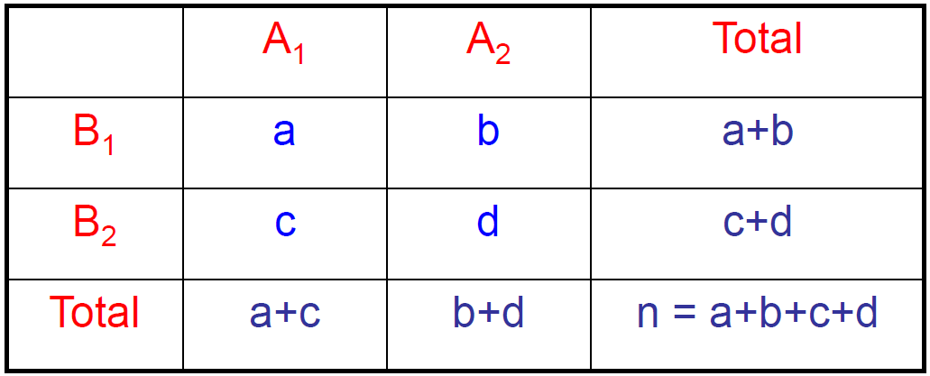
Occurrence Count Tabulation
CONTINGENCY or CROSSTABULATION
Presents counts of two or more variables

Slide 4
Joint, Marginal, and Conditional Probability
We study methods to determine probabilities of events that result from combining other events in various ways.
There are several types of combinations and relationships between events:
Intersection of events (Joint Probability)
Union of events
Dependent and independent events
Complementary events

Slide 5
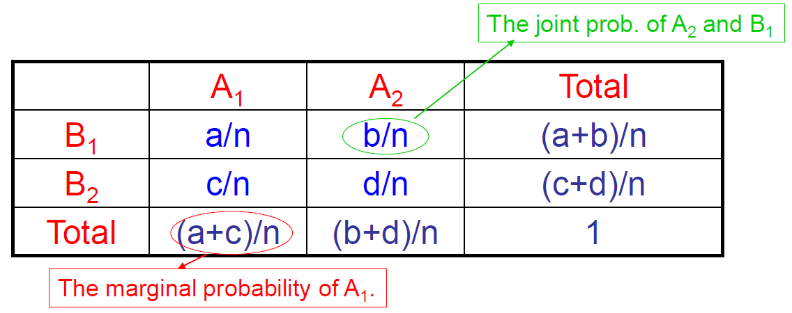
Joint, Marginal, and Conditional Probability
Joint probability is the probability that two events will occur simultaneously
Marginal probability is the probability of the occurrence of the single event.

Slide 6
Study
ADOLESCENTS’ UNDERSTANDING OF SOCIAL CLASS
study examining teens’ beliefs about social class
sample: 48 working class and 50 upper middle class 16-year-olds
study design:
“objective” assignment to social class based on self reported measures of parents’ occupation and education, and household income
“subjective” association based on survey questions
Class that students think they belong to.

Slide 7
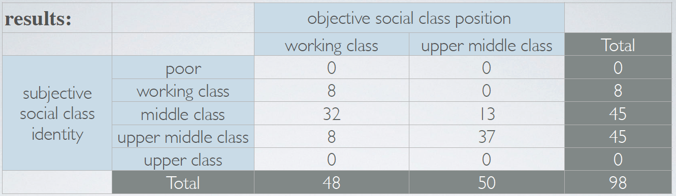
Study Data

Slide 8
Marginal Probability
What is the probability that a student’s objective social class position is upper middle class?

Slide 9
Marginal Probability
What is the probability that a student's subjective social class identity is upper middle class?
a) 45 / 98 ≈ 0.46
b) 8 / 48 ≈ 0.17
c) 8 / 45 ≈ 0.18
d) 37 / 50 ≈ 0.74
e) 37 / 45 ≈ 0.82

Slide 10
Joint Probability
8
37
13
13
8
What is the probability that a student’s objective and subjective identity are both upper middle class?

Slide 11
Joint Probability
What is the probability that a student's objective and subjective class is working class?

Slide 12
Conditional Probability
What is the probability that a student who is objectively in the working class associates with upper middle class?

Slide 13
Conditional Probability
If a student's objective class position is upper middle class, what is the probability that they associate with middle class?

Slide 14
Conditional Probability
The probability that event A will occur given that or on the condition that, event B has already occurred.
It is denoted by P(A|B)
P(A|B) = (Joint Probability of A&B) / (Marginal Probability of B)
Bayes’ Formula

Slide 15
Conditional Probability
Probability of Subjective Upper Middle (Subj_umc) class given that the student is in Objective Working class?

Slide 16
Bayes’ Formula
Note: we already arrived on this answer by just simply reasoning through the table.
What if we don’t have information neatly organized in contingency table ?

Slide 17
Example
The American Community Survey is an ongoing survey that provides data every year to give communities the current information they need to plan investments and services.
The 2010 American Community Survey estimates that
14.6% of Americans live below the poverty line,
20.7% speak a language other that English at home,
and 4.2% fall into both categories.
Based on this information, what percent of Americans live below the poverty line given that they speak a language other than English at home?

Slide 18
Example
P(below PL | speak non-Eng) = ?
P(below PL & speak non-Eng)
0.042
=
=
= .2
P(speak non-Eng)
0.207

Slide 19
Example
what percent of Americans who live below the poverty line also speak a language other than English at home?
P(speak non-Eng | below PL ) = ?
P(below PL & speak non-Eng)
0.042
=
=
= .29
P(below PL )
0.146

Slide 20
Product rule for independent events:
If A and B are independent,
P(A and B) = P(A) x P(B)
How about dependent events ?
Or, if we want to check if two event are dependent

Slide 21
Independence and Conditional Probability
Generically, if P(A|B) = P(A) then the events A and B are said to be independent.
Conceptually: Giving B doesn’t tell us anything about A.
Mathematically: If events A and B are independent, P(A and B) = P(A) × P(B). Then,

Slide 22
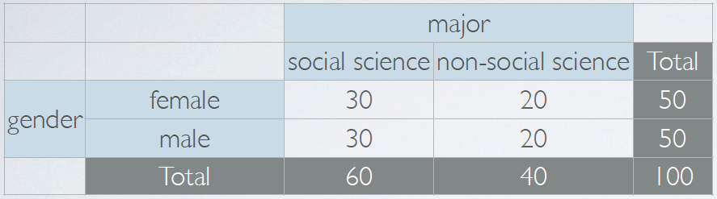
Example
Gender and Major are Independent or Dependent ?
P(SS) = 60/ 100 = 0.6
Condition on Gender ➔ P(SS | F) = 30/ 50 = 0.6
Condition on Gender ➔ P(SS | M) = 30/ 50 = 0.6
Given the distribution, Gender and Major are Independent

